Slide 1



TLA+ and model-checking in practice
Tomek Masternak
@Masternak
https://exactly-once.github.io/
Notes:
1. Hi everyone, my name is Tomek and in this talk I’ll be talking about Model-checking and TLA+
2. Working at Particular Software
3. I’m on Tweeter and at exactly-once

Slide 2
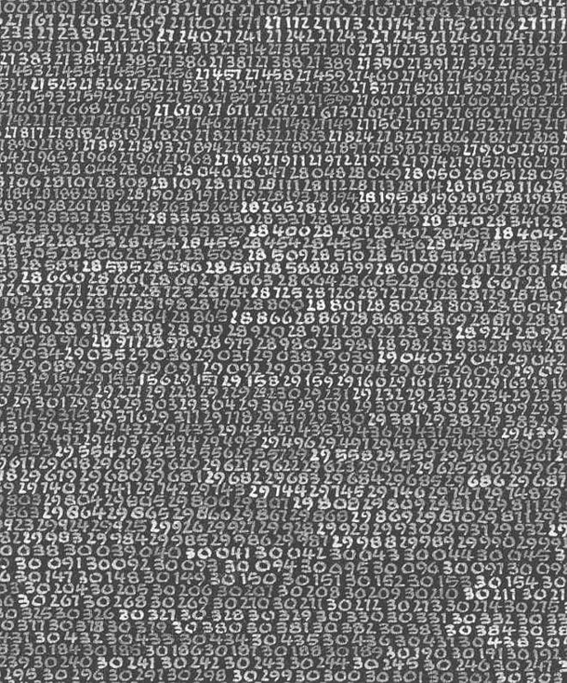
Model-checking
Notes:
Let’s start with defining what model-checking even is
In some areas of IT it’s quite well known but in others including Distributed Systems it’s only getting some traction

Slide 3
Testing
Generation
property-based testing
Automatic
Implementation
model-checking
Model
Manual
Integration tests
exploration tests
smoke tests
unit tests
Execution
Manual
Automatic

Slide 4
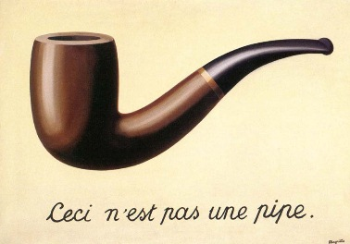
What makes a good model?
Notes:
Model is a SIMPLIFICATION made for particular PURPOSE
Modeling is deciding on what to keep and what to remove
Example of calculator model and pushing the buttons (by Lamport)
For the purpose of distributed systems testing we need our model to be able to express concurrency and partial failures

Slide 5
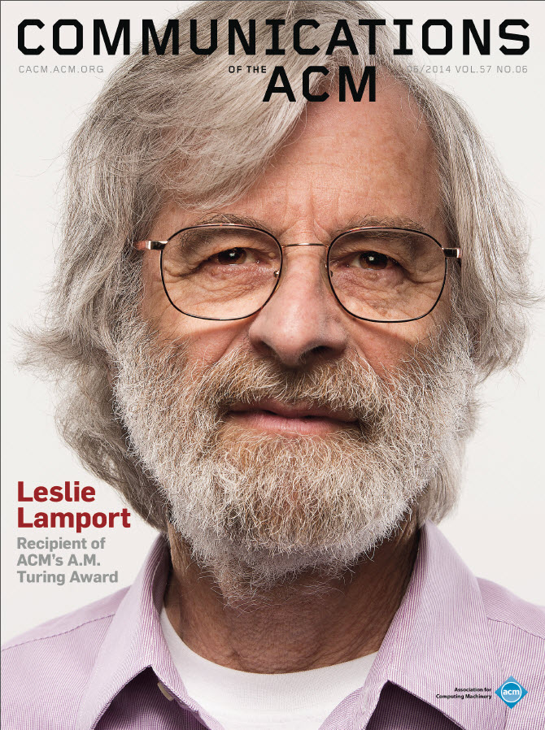
Temporal Logic of Actions
Notes:
Known for Paxos, Two-general problem, Logical Clocks, LateX, Chandy-Lamport Snapshot algorithm (…)
Introduced with the paper "Specifying Concurrent Systems with TLA⁺" in 1999
Provides support for more “user-friendly” syntax

Slide 6

Temporal Logic of Actions
Notes:
Known for Paxos, Two-general problem, Logical Clocks, LateX, Chandy-Lamport Snapshot algorithm (…)
Introduced with the paper "Specifying Concurrent Systems with TLA⁺" in 1999
Provides support for more “user-friendly” syntax

Slide 7
TLA+: Temporal logic of actions
A4
…
S1
A5
A1
A2
+
Invariants*
S0
S2
…
A3
S3
…
*and more
Notes:
What makes a good model of a system for purpose of testing distributed system?
Model needs to express
Concurrency (indeterminism)
Partial failures
I’m going to focus on safety and not liveness properties
Each state is a set of variables with their values

Slide 8
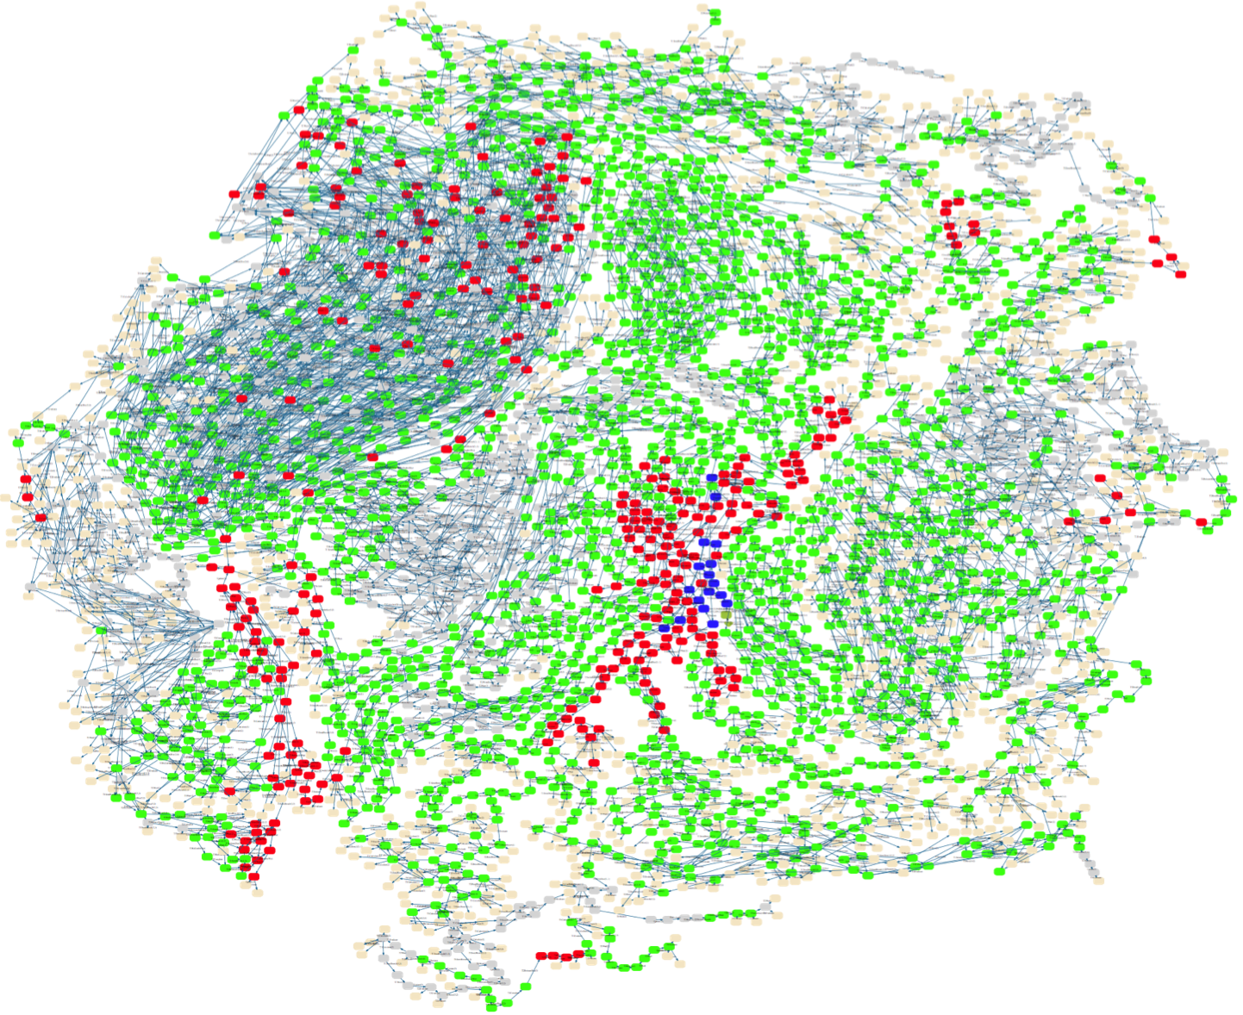
Generation
https://www3.hhu.de/stups/prob/index.php/File:CANBus_sfdp.png
Notes:
1. Explain how the model checker works

Slide 9
In Summary
Implementation
TLA+ Model
Model Checker
YES/NO*
Algorithm
Invariants

Slide 10
Outbox pattern
endpoint
input queue
output queue
threads
6
5
2
4
3
1
database

Slide 11
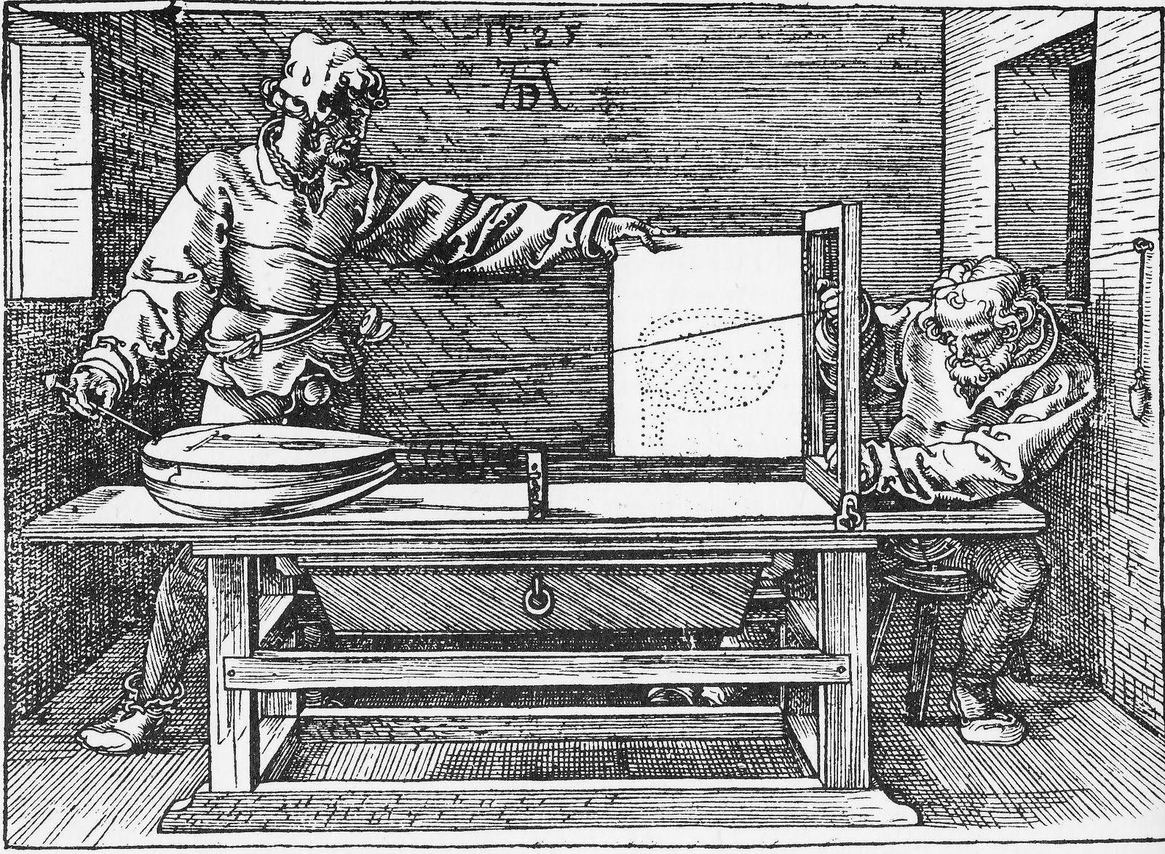
Execution

Slide 12
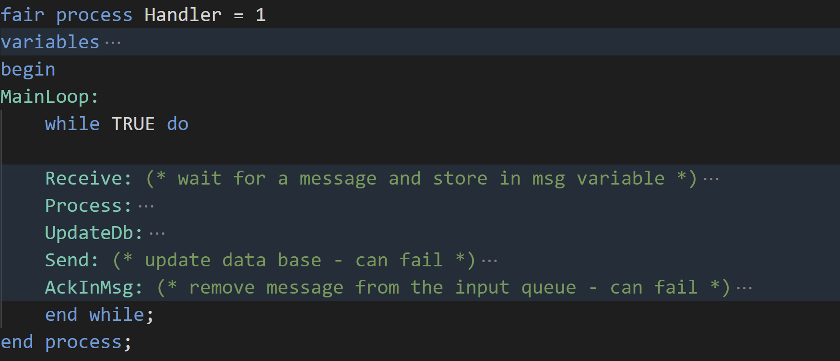
Modeling execution
Notes:
Concurrency gets modelled via atomic step definitions (label-to-label stepping)
Indeterminism is defined via either-or
Failures are defined via macro

Slide 13
Modeling state

Slide 14
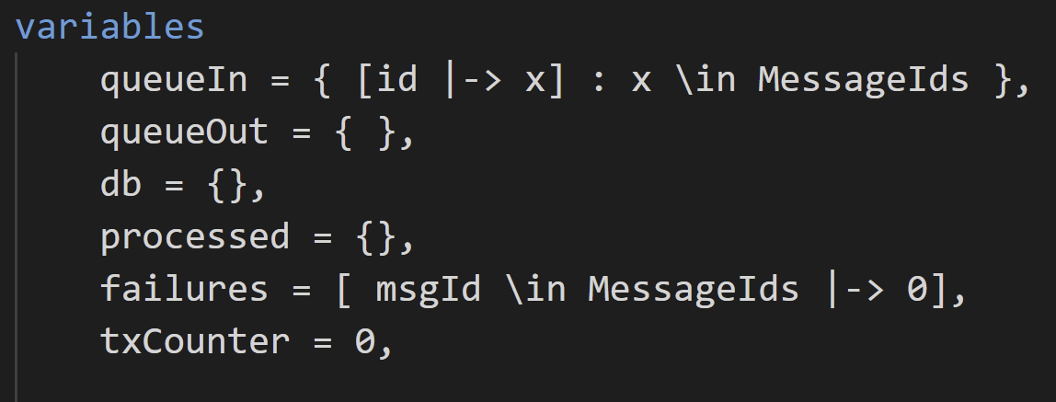
Global state

Slide 15
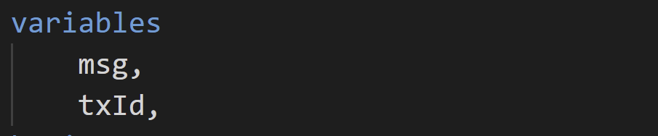
Process state *
* - “Program Counter” per PlusCal process

Slide 16
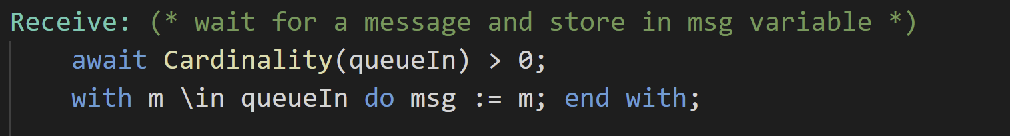
Receive

Slide 17
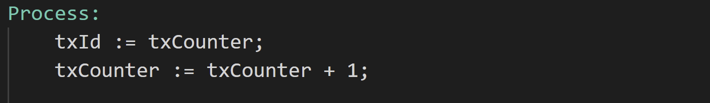
Process

Slide 18
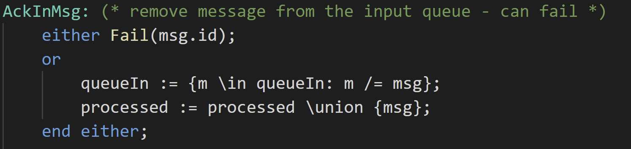
Ack

Slide 19
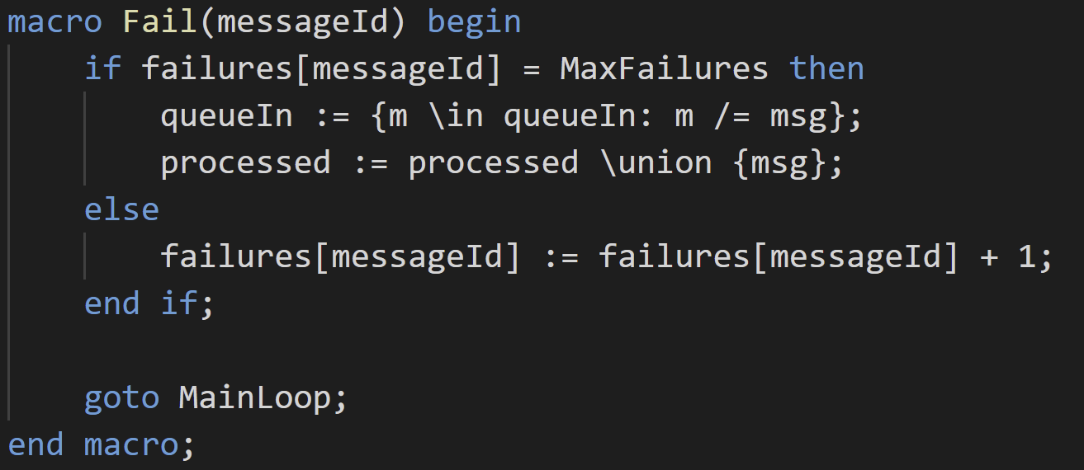
Failure

Slide 20
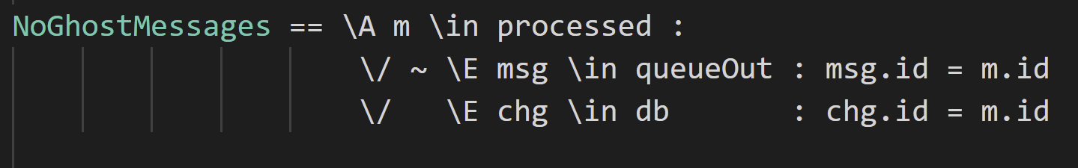
Invariants

Slide 21
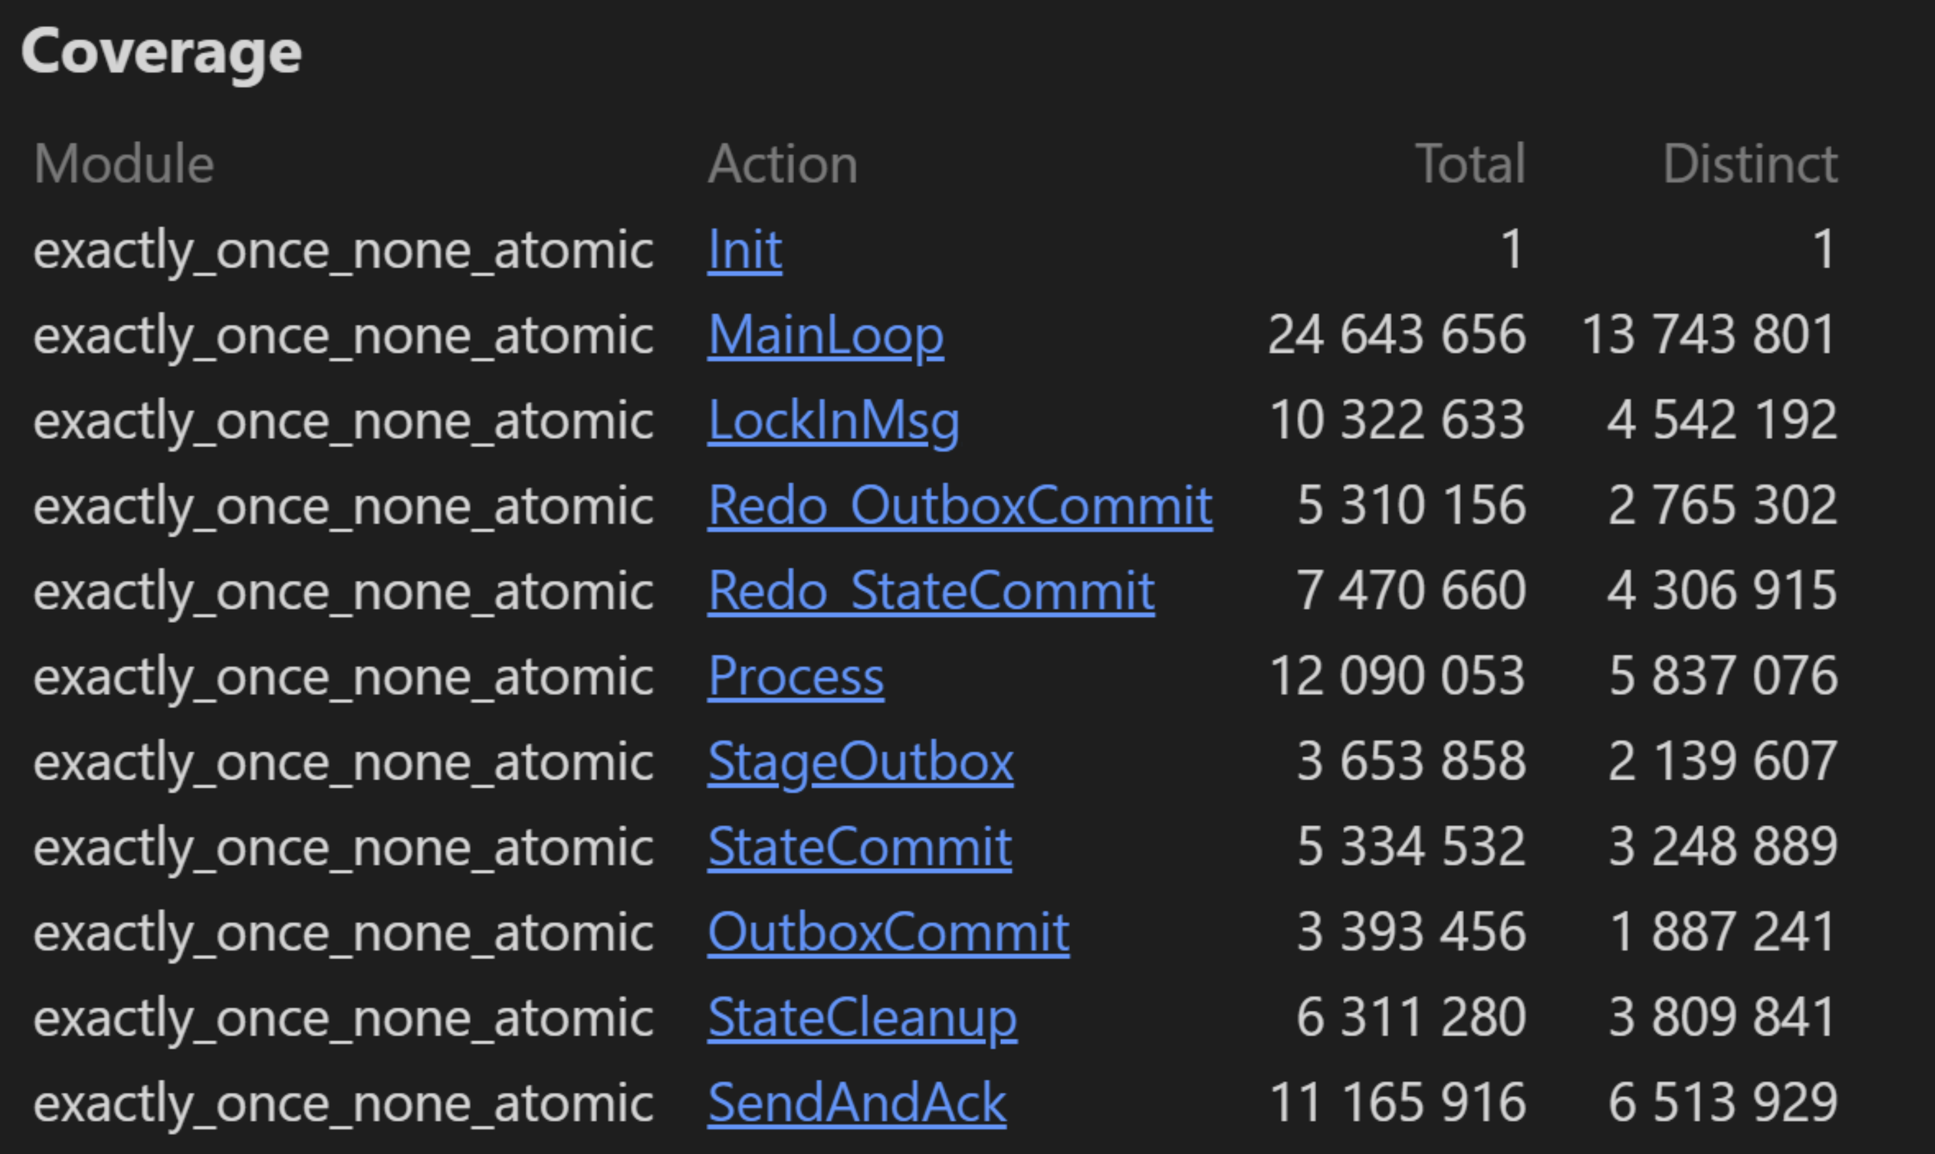
Model size
Notes:
1. Small model hypothesis

Slide 22

No free dinners
Notes:
What to model (integration parts and protocols)
Make model finite
Model is not the implementation
To make a sensible model you need to know the technology really well

Slide 23
Try it yourself!
https://github.com/exactly-once/workshop/blob/master/model-checking

Slide 24
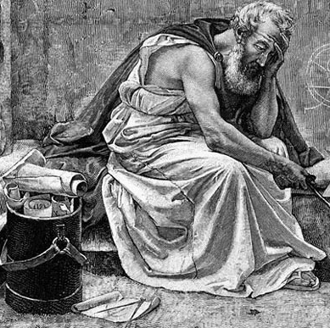
Questions?

Slide 25
Tooling
Visual Studio Code or Eclipse

Slide 26
Model-checking
What is it?
Testing chart
What is modeling. What makes a good model for testing distributed systems?

Slide 27
TLA+ in Particular
Background history on TLA+
What is Standard Model
States, transitions and temporal formulas

Slide 28
Outbox
Idea behind the outbox and the chart diagram
How to express that in TLA+ (what to keep and what to leave)
PlusCalc
How to model system state (whole world picture)
Model walk-through

Slide 29
Model checker gotachas
Model size
Small model hypothesis

